Slide 1
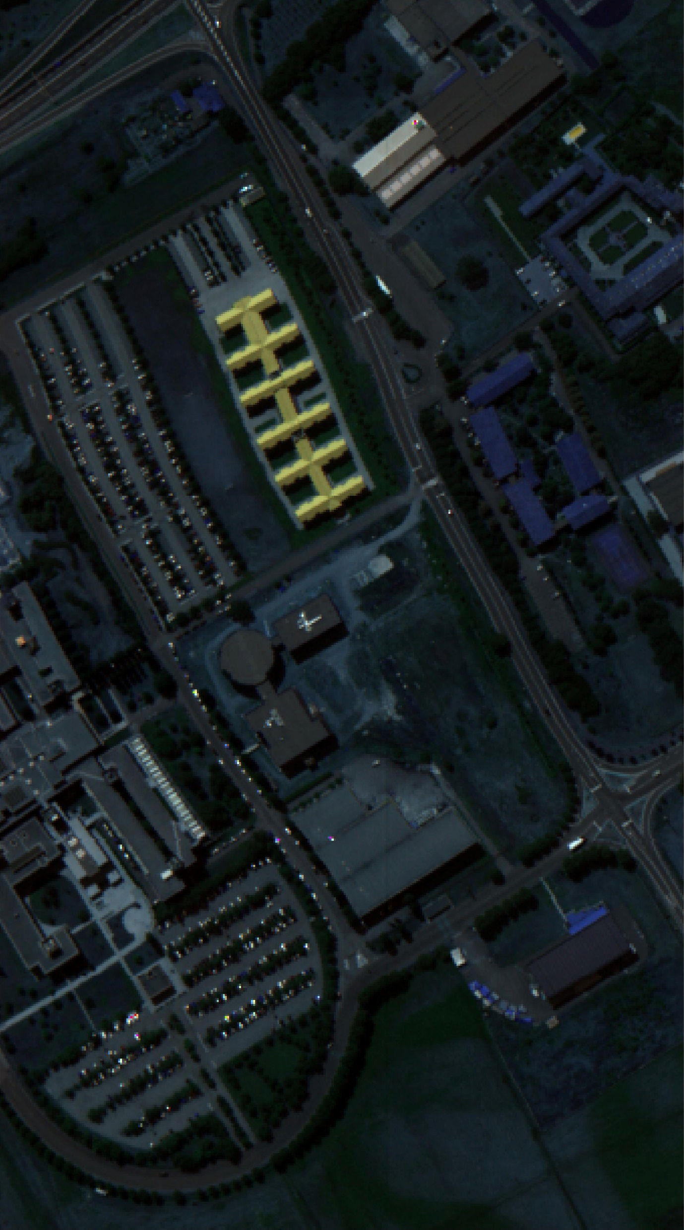
(a)
(b)
(c)
(d)
Asphalt
Meadows
Gravel
Trees
Painted-metal-sheets
Bare Soil
Bitumen
Shadows
Self-Blocking-Bricks

